Slide 1

Phase 5 Watershed Model
STAC Model Review
January 23, 2008
Gary Shenk
CBPO Modeling Group

Slide 2
Overview
Phase 5 Watershed Model Structure
Upgrades from phase 4.3
Inputs
Calibration Methods
Thoughts on Uncertainty Analysis

Slide 3
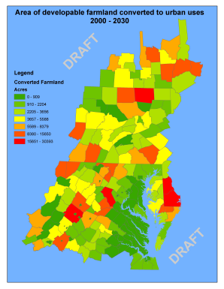
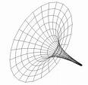
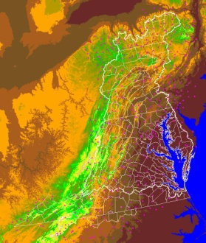
Chesapeake Bay Program Decision Support System
Land Use
Change Model
Bay
Model
Criteria
Assessment
Procedures
Watershed
Model
COAST
Data
Airshed
Model
Effects
Allocations

Slide 4
Quick overview of watershed model Calibration
Annual or Monthly:
Land Use Acreage
BMPs
Fertilizer
Manure
Atmospheric Deposition
Point Sources
Septic Loads
Hourly Values:
Rainfall
Snowfall
Temperature
Evapotranspiration
Wind
Solar Radiation
Dewpoint
Cloud Cover
HSPF
Daily output compared
To observations

Slide 5
Each segment consists of separately-modeled land uses
High Density Pervious Urban
High Density Impervious Urban
Low Density Pervious Urban
Low Density Impervious Urban
Construction
Extractive
Wooded
Disturbed Forest
Corn/Soy/Wheat rotation (high till)
Corn/Soy/Wheat rotation (low till)
Other Crops
Alfalfa
Nursery
Pasture
Degraded Riparian Pasture
Animal Feeding Operations
Fertilized Hay
Unfertilized Hay
Nutrient management versions of the above
Plus Point Source
and Septic
Each calibrated to nutrient and
Sediment targets

Slide 6
Each submodel has a complex hydrologic or nutrient cycling structure
Trees
Denitrification
Roots
Leaves
Nitrate
Atmospheric Deposition
Export
Solution
Particulate
Particulate
Ammonia
Labile
Refractory
Organic N
Organic N
Export
Export
Export
Export
Export
Export
Adsorbed
Solution
Solution
Ammonia
Labile
Refractory
Organic N
Organic N

Slide 7
BMPs
Fertilizer
Atmosphere
Manure
Runoff

Slide 8
BMPs
Nutrient
Management
Fertilizer
Atmosphere
Manure
Runoff

Slide 9
BMPs
Fertilizer
Atmosphere
Manure
Runoff

Slide 10
BMPs
Land Use
Change
Fertilizer
Atmosphere
Manure
Runoff

Slide 11
BMPs
Fertilizer
Atmosphere
Manure
Runoff

Slide 12

BMPs
Structural
BMPs
Fertilizer
Atmosphere
Manure
Runoff

Slide 13
Phase 5 Development
Phase 4
Phase 5

Slide 14
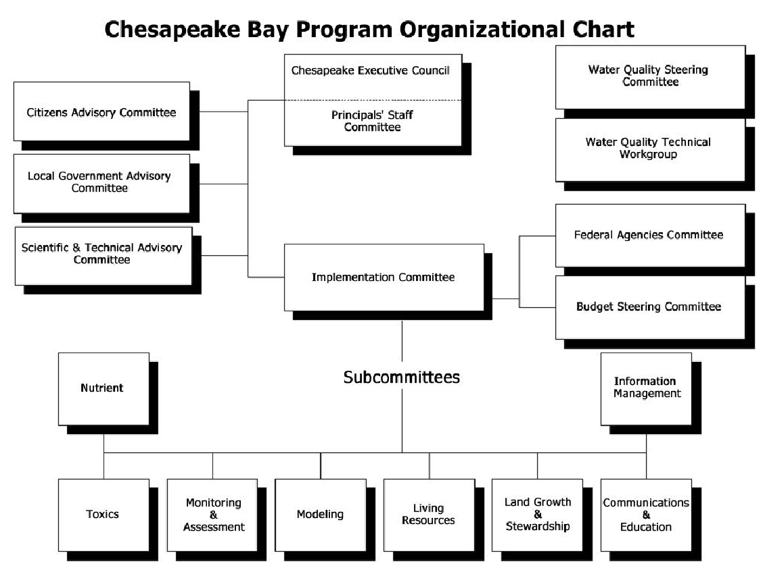
Technical Review
Scientific & Technical
Advisory Committee
Agriculture
Nutrient
Forestry
Urban
Point Source
Modeling

Slide 15
Input Data
Agriculture
Nutrient
Forestry
Urban
Point Source
Monitoring
& Assessment
Land Growth
& Stewardship

Slide 16
Watershed Model History

Slide 17
Watershed Model History
Management questions and model have been both increasing exponentially in complexity.

Slide 18
Integrated model built by integrated community of decision makers and modelers
Maryland Department of the Environment
Virginia Department of Conservation and Recreation
Chesapeake Bay Program
Developers
EPA
U of Maryland
USGS
NRCS
Chesapeake Research Consortium
Virginia Tech
$
Interstate Commission on
the Potomac River Basin
$
$
Advisors and data suppliers
State Governments of
NY, PA, MD, DE, VA, WV, DC
Scientific and Technical Advisory Committee
USGS
* STAC review is 200th presentation! *

Slide 19
Major Advances in Phase 5
Fine segmentation
Flexible functionality
Better input data
Transferability / User-friendliness
Automated calibration

Slide 20
Fine Segmentation
Phase 4
Phase 5

Slide 21
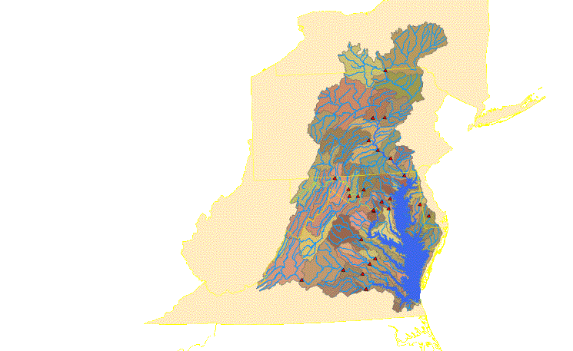
Phase 4.3 and Phase 5 Calibration Stations
Phase 4.3 Calibration
Phase 5 Calibration
Calibration sites = 20
Land Segments = 94
River Segments = 94
Land uses = 9
Simulation Years = 10
Calibration sites = 287
Land Segments = 308
River Segments= 1,063
Land uses = 24
Simulation Years = 21

Slide 22
Phase 5 land segmentation is primarily county-based
Some counties were divided to accommodate different rainfall patterns.
Reasons why counties are a practical choice for segmentation:
Most counties are completely within a hydrogeomorphic region
BMP and Crop data are not known on a finer scale in most cases
Near the limit of computing capacity

Slide 23
Phase 5 river segmentation
Consistent criteria over entire model domain
Greater than 100 cfs
or
Has a flow gage
Near the limit of meaningful data

Slide 24
With different and non-nesting land and river segmentation schemes, how do you run the model?
The river segment (shown in black outline) must take inputs from four different land segments (shown in red outline)
The intersection of land segment and river segment should have a particular land use acreage based on satellite imagery, not just proportional to the land segment as a whole.

Slide 26
HSPF
Typically store land and river inputs in the same file
With overlapping segmentation, there is no ‘break point’ where files could be independent
Option 1 – store entire study area in one file
Option 2 – store land and river separately

Slide 27
Logistics problem
308 land segments and 24 land use types = 7392 independent land simulations requiring 7392 input files that must be modified during calibration and scenarios
739 rivers requiring input files
45,348 land use / river connections
52,896 land use or river / bay model connections

Slide 28
Flexible Functionality
{
Nutrient
Application
Database
Module
Specification
Database
Process
Parameter
Database
Control file
Land Input File Generator
Each land use type simulation within each land segment requires a unique input file. Software was developed to automatically generate these.

Slide 29
{
Module
Specification
Database
Process
Parameter
Database
Control file
River Input File Generator
Each river simulation also requires a unique input file. Software was developed to automatically generate these.

Slide 31
Since this software is outside of HSPF, we can incorporate other features, for example, land use change or BMP change over the course of the calibration 1984-1999
External
Transfer
Module
Land use change in the Patuxent Basin 1982-2002

Slide 32
ETM Functionality
Interposing non-HSPF software between the land and river simulation allows for opportunity to address issues of flexibility that are difficult to manage in traditional HSPF applications, including:
External
Transfer
Module
Time Varying Land Use
Time Varying BMPs
Sub-grid effects (differential land-to-river transport)
Overall Flexibility

Slide 33
Model Software Structure
WDM = HSPF-specific binary file type
UCI = User Controlled Input (input file)
MET
WDM
ATDEP
WDM
PS
WDM
Land Input File Generator
River Input File Generator
1
4
External
Transfer
Module
2
3
5
Land variable
WDM
River variable
WDM
Final Text
Output
6
Land UCIs are generated
HPSF is run on the land UCIs and output is stored in individual WDMs
The ETM is run converting land output to river input, incorporating land use, BMPs, and land-to-water delivery factors. Output is stored in river-formatted WDMs
River UCIs are generated
HSPF is run on the river UCIs and output is written back to WDMs
Postprocessor reads river WDMs and writes ASCII output

Slide 34
Overall software system functionality
River Input File Generator
The software system devised for phase 5 has other advantages over a traditional HSPF application:
External
Transfer
Module
Land Input File Generator
Easily allows large-scale parameter adjustments during calibration
Parallel computing operations convenient
Easy to add new land use types
Easily integrated into outside databases for scenarios
Relatively Easy to add new WQ constituents (bacteria)

Slide 35

Open-Source Model
Transferability
Entire model available on web
Input data
HSPF
Phase 5 system
Already in Use
Community model in Climate Change Study
Community model at ICPRB
Phase 5 output in Potomac PCB TMDL
Phase 5 information in MDE TMDLs
Phase 5 information in USGS Watershed Study
USGS Shenandoah Models
Phase 5 output in Academic studies

Slide 36
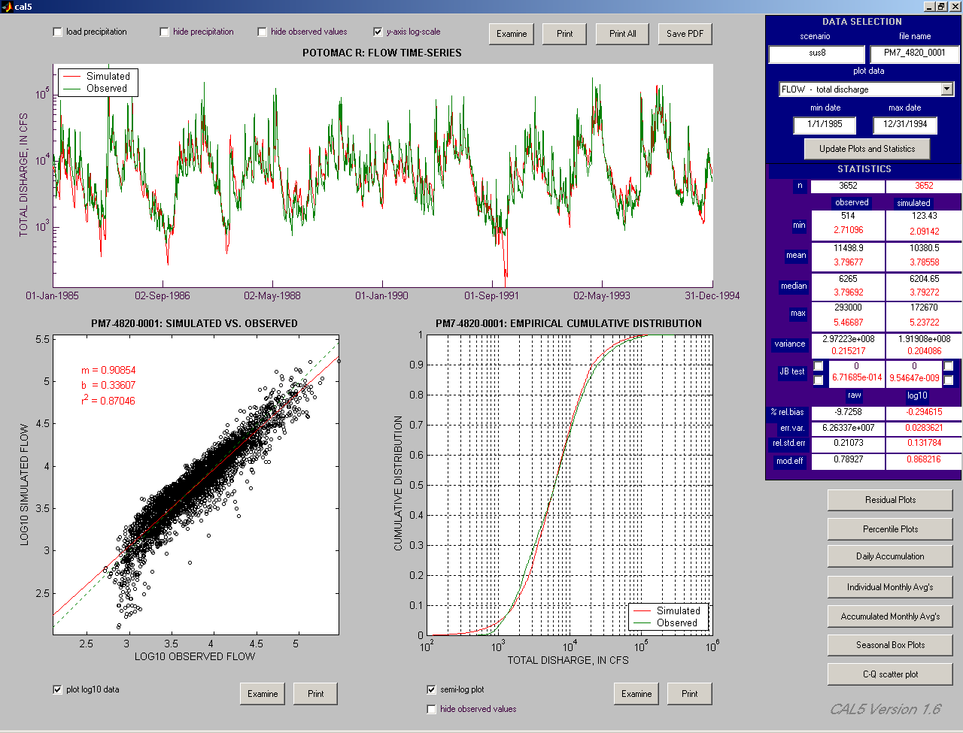
User-Friendliness
Matlab-based Calibration Viewer
Programmed by Joe Vrabel at USGS - Baltimore

Slide 37
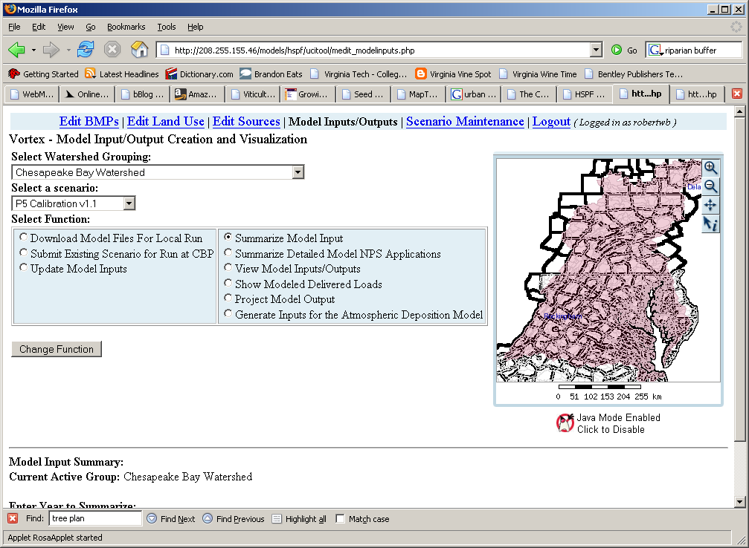
User-Friendliness

Slide 38
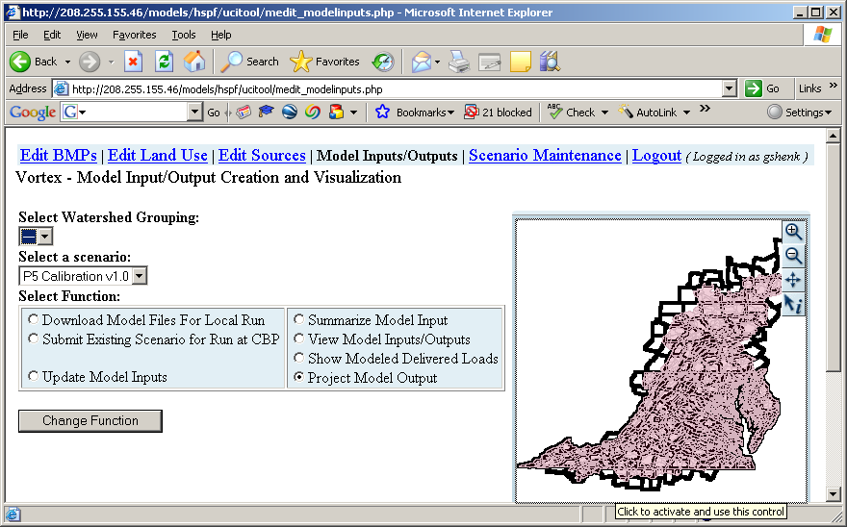




Chesapeake Online Assessment Support Tool
Crops
Land-Use
Watershed /
Airshed /
Estuary
Model
Sources

Slide 39
What Can COAST Tell Us?
The effects of:
Land-use changes
Best Management Practices
Changes in cropping patterns
Changes in nutrient input loads:
Amount of fertilizer, manure, atmospheric deposition
Population growth (human/livestock)
Nutrient Management
Point source
Septic

Slide 40
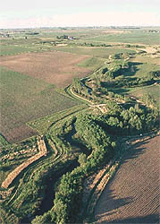
Example: Forest Buffers
A planner wants to estimate the effects of adding 2,000 acres of forested buffer to agricultural lands in the Patuxent River watershed.

Slide 41
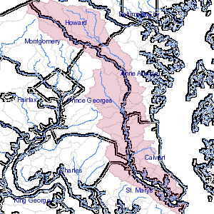
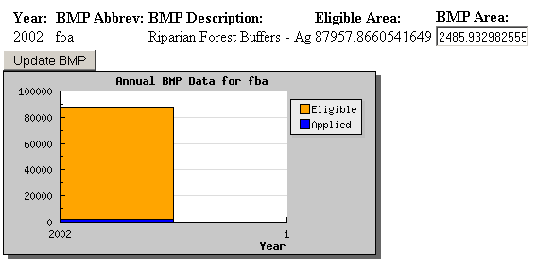
BMP Editing Screen
Use selects Patuxent Watershed
Screen Prompts User with Eligible Area, user enters desired BMP

Slide 42
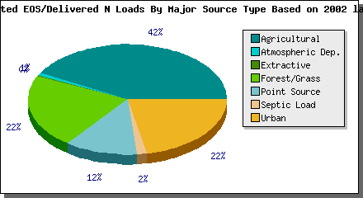
Results: Adding Forest Buffers
Before:
After:
7% reduction N
5% reduction P

Slide 43
Better, extended, and finer scale data sets
High Resolution Input Data
Precipitation
Temperature
Evapotranspiration
Wind
Solar Radiation
Dewpoint
Cloud Cover
Land Use Acreage
BMPs
Fertilizer
Manure
Atmospheric Deposition
Point Sources
Septic Loads
Simulation period is 1984-2005:
Two decades of meteorology and watershed management data

Slide 44
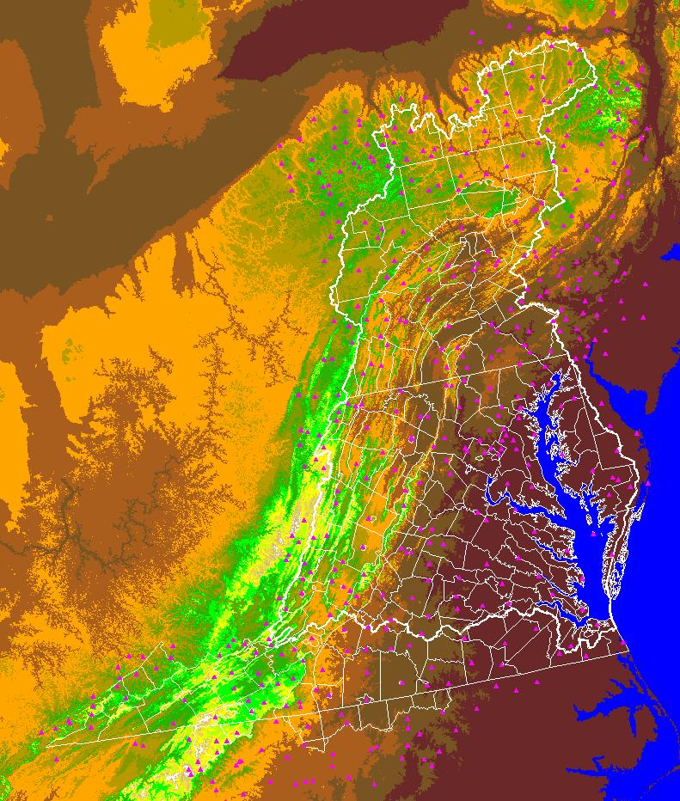

Rainfall
487 daily stations
192 hourly stations

Slide 45
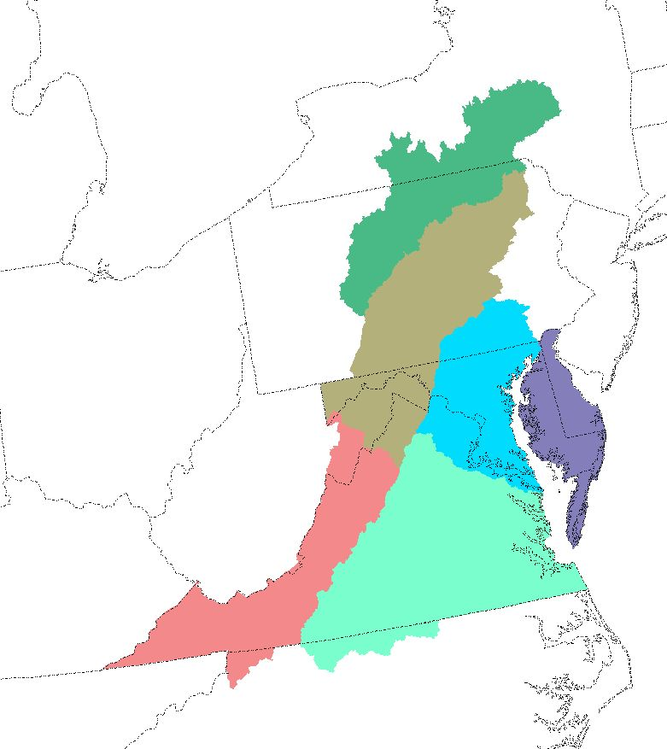
Rainfall
Data are separated by region and by month

Slide 46
Methodology
Rainfall
Multiple linear regression (MLR) equations are developed for daily precipitation (p) using independent variables x, y, and z from climate stations.
The general form of the MLR equation is:
b₁, b₂, and b₃ are calibrated by month (all Januaries, all Februaries . . .)
b₀ is recalibrated every day and over small spatial scales to minimize local errors

Slide 47
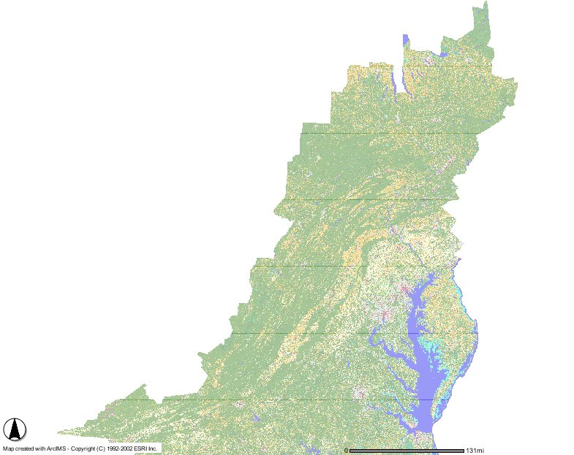
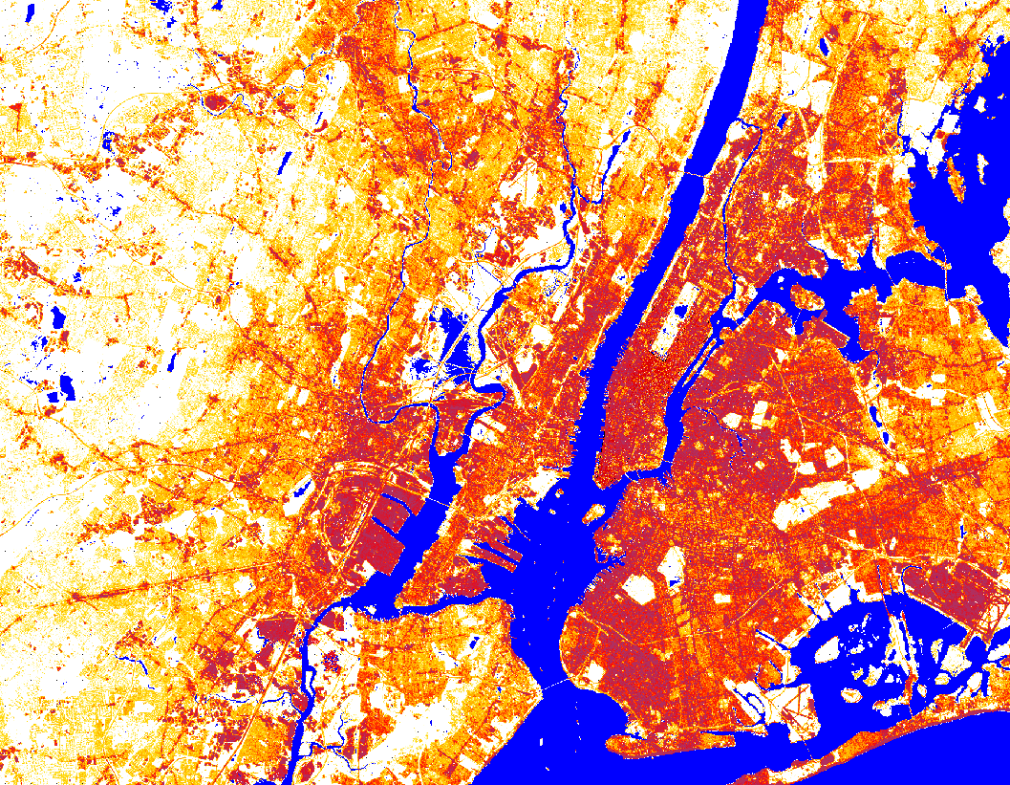
The land use data set is a product of land cover, impervious percents, the US census of agriculture and an urban forecast and hindcast based on census data and density analysis
Land Use Data Set
U.S.
Census of Agriculture
1982
1987
1992
1997
2002
+
Urban Forecast
and Hindcast
+

Slide 48
Watershed Model
Input Data
Chesapeake Bay Land Change Model
Sewer Service
Areas
COG and MDP
Demographic
&
Employment
Forecasts
Growth
Allocation Model
“GAMe”
Sewer Model
Sewer
outflows
Septic
loads
Calibration
Metrics
Future
Urban Area
Slope,
Protected
lands,
Zoning,
Priority Funding
Areas
Cellular Automata
Model
“CB-SLEUTH”
Proportions of
farm and forest
converted
Land Use/
Land Cover
(NLCD)
1990 Impervious
Surface
and
2000 Impervious
Surface

Slide 49
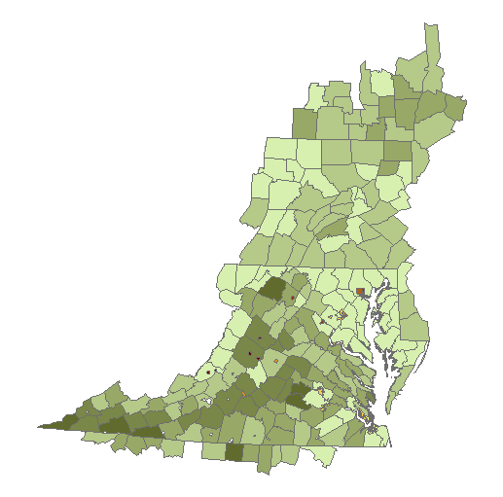
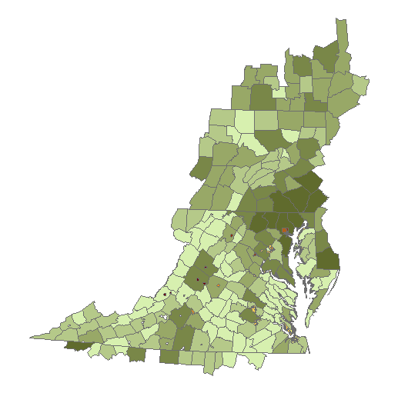
Septic Loading Rate
Systems per acre Low-Density
Total Number of Systems
Low
Septic Accounts for approximately 4% of total N produced in the watershed. Darker color indicates higher density.
High

Slide 50
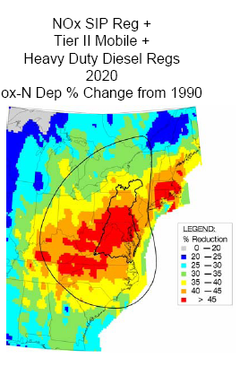
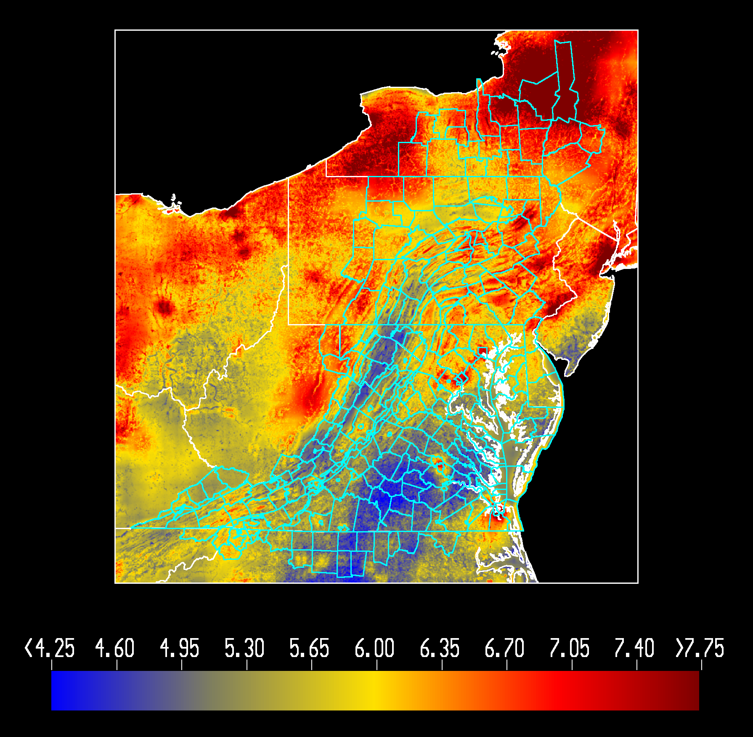
Atmospheric Deposition Estimates
Combining a regression model of wetfall deposition...
…with CMAQ estimates of dry deposition for the base…
…and using the power of the CMAQ model for scenarios.

Slide 51

River Geomorphology Data
Needed rough geomorphology of approximately 800 rivers
Had data for about 200 with USGS flow gages
Followed Leopold and Maddock (1953) to develop regression equations for each for each region for
Bankfull depth
Bankfull width
Bottom depth
Versus drainage area
Work performed by Doug Moyer at USGS - Richmond

Slide 52
River Geomorphology Data
Bottom Width vs Drainage area in the Piedmont

Slide 53
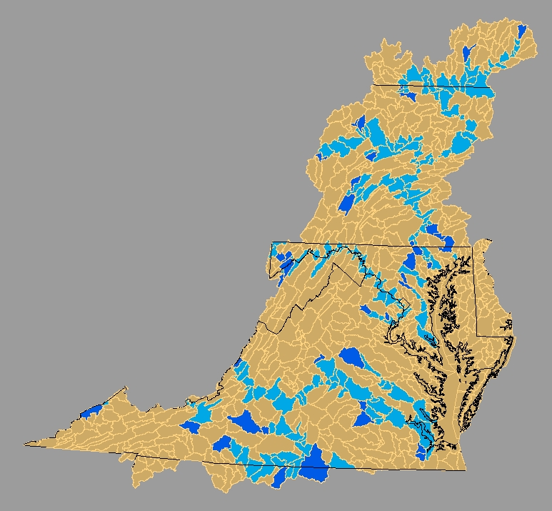
Reservoir Affected Reaches
Reservoir
Downstream of Reservoir
Reservoir work performed by Alan Simpson at USGS - Richmond
Including 81 calibration stations
40 simulated reservoirs, up from 6 in phase 4

Slide 54
Reservoir operations were simulated by varying the geometry of the river over the course of a year.
The above example is a double-pool reservoir. Some reservoirs had as many as six target pool levels during each year and some had only one target pool level

Slide 55
Watershed Wide Crops by Acreage

Slide 56
Manure Data Model
Volatilization
Volatilization
Volatilization
Uncollected
Pasture
Volatilization
Beef
Dairy
Collected
Swine
Enclosure
Daily Application
Layers
Broilers
Turkeys
Storage
Crop
Spring/Fall
Application
Volatilization
Barnyard
Daily Application
Runoff
Runoff

Slide 57
Volatilized fertilizer NH3
Fertilizer Sold
NM crops w/o manure
NM acres w/ manure
starter fertilizer, with manure applied after
Manure on NM acres
Acres of crop w/o manure
Non-NM acres
Manure Mass-balance
Non-NM acres w/ all leftover fertilizer
Non-NM acres w/ leftover manure

Slide 58
BMPs
2 – Year literature review by Tom Simpson
UMd and
Mid-Atlantic
Regional Water Program
Fertilizer
Atmosphere
Manure
Runoff

Slide 59
Better and extended data sets
Point Sources – from monthly DMRs
Water Diversions – compiled by USGS - Richmond

Slide 60
Automated Calibration
Ensures even treatment across jurisdictions
Fully documented calibration strategy
Repeatable
Makes Calibration Feasible
Enables uncertainty analysis

Slide 61
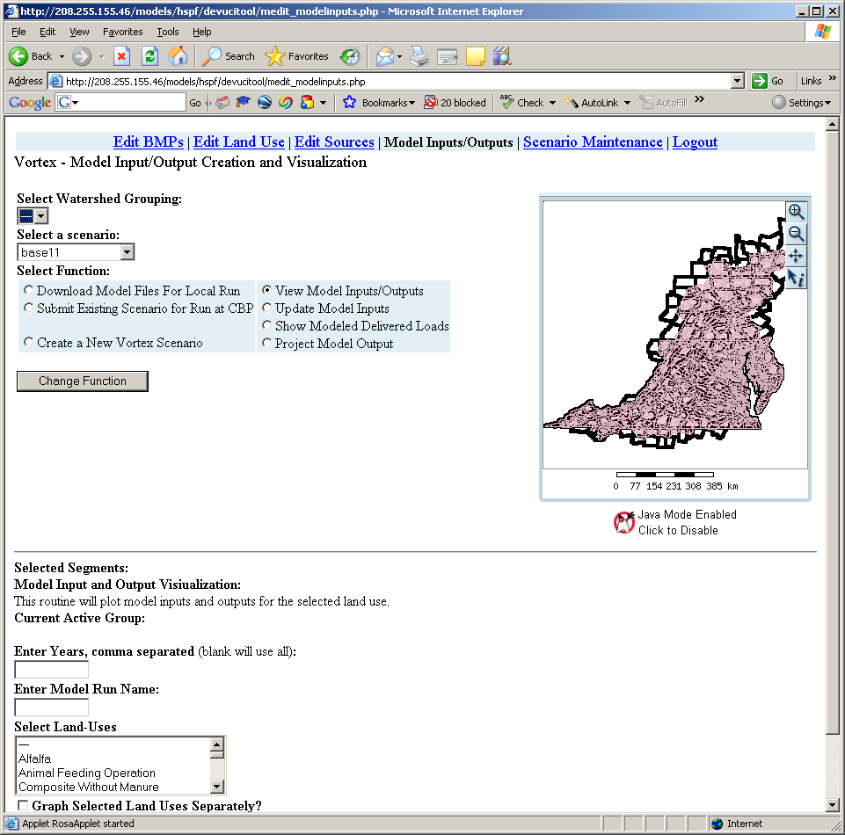
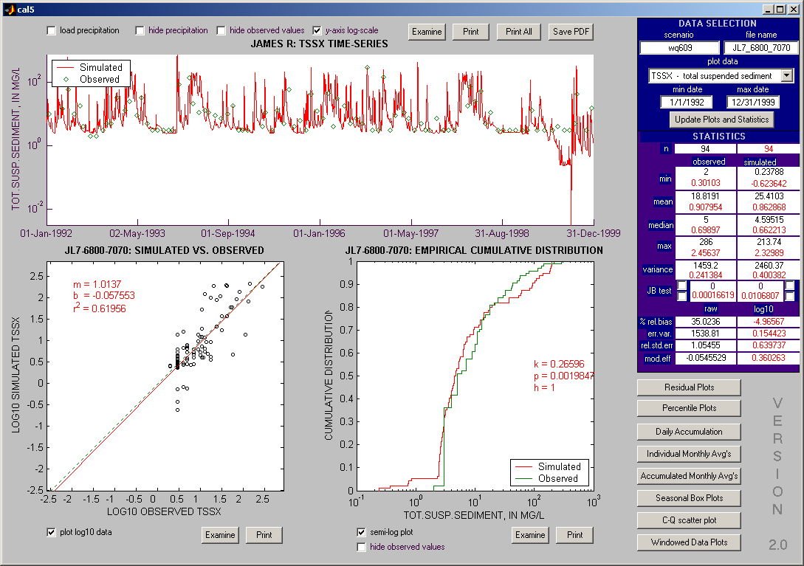
Automated Calibration
Calibration
Procedures
Input Data
“COAST”
Calibration
Data

Slide 62
How do we calibrate?
Reasonable values of sediment, nitrogen, and phosphorus
River Reach
Observations of flow, sediment, nitrogen, and phosphorus
Notes:
The Chesapeake Bay Program’s application of HSPF simulates water, nutrients and solids with a 1-hour time step.
The illustration above gives an overview of the solids processes in HSPF.
Each hour that it rains, based on real weather data, rainfall energy causes sediment to be detached from the soil matrix. This detached sediment is then available for washoff into the river.
The river simulation then transports, settles, and scours sediment on an hourly basis.

Slide 63
Scale of Phase 5 Output
INPUTS:
Manure fertilizer atmospheric deposition
County-level
Improved in
Phase 5
LAND USES:
County-level
More Than
Doubled in
Phase 5
RIVERS:
Watershed-based
Order of Magnitude
Increase in Phase 5
MONITORING STATIONS:
Multiple watersheds
Order of Magnitude
Increase in Phase 5

Slide 64
Calibration Process
Time
Hydrology
Land parameters
River data
1 week
Discuss for each:
Targets
Procedures
Results
Temperature
Land parameters
River parameters
River data
Land Sediment
Land parameters
Land targets
1 week
Land Nutrients
Land parameters
Land targets
1 week
River Water Quality
River parameters
River targets
2 weeks

Slide 65
HYDROLOGY Calibration

Slide 66
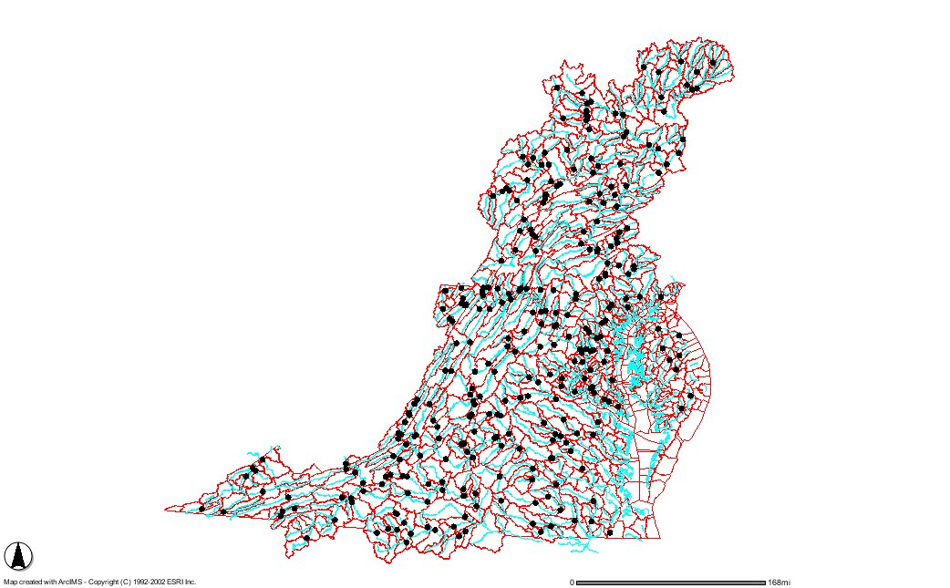
Phase 5 Rivers, Segments, and Flow Calibration Stations

Slide 67
Daunting Problem
308 Land Segments
16 land uses
21 parameters per land use
Not counting start 4 parameters that can vary monthly
Not counting 7 initial condition parameters
Grand total of 103,488 parameters controlling hydrology

Slide 68
Reducing the parameter set
308 Land Segments
16 land uses
ratio parameters to a ‘master’ land use
Infiltration is lower in compacted land uses
Ground water parameters are generally independent of land use
21 parameters per land use
3 can be set by GIS data
10 are insensitive
1 is generally related to another calibrated parameter
7 are sensitive
308 X 7 = 2156 parameters to calibrate
285 calibration stations

Slide 69
Sensitivities
Calibration Measure
HSPF Parameter
Overall Bias
Winter / Summer Balance
Baseflow / Stormflow Balance
Quickflow Recession Index
Baseflow Recession Index
Peak Bias
land evap
LZSN and AGWETP
INFILT
IRC
AGWR
INTFW
Through calibration experience and by referencing the HSPEXP expert system, the following sensitivities were found between calibration metric and HSPF parameters.
Notes:
The experience of hand calibration had supplied us with the same type of knowledge that can be found in HSPEXP, but it was more specific to our application.
We also think that our statistics are better that HSPEXP. For example, our baseflow / stormflow balance is determined by hydrograph separation using the USGS PART program. HSPEXP takes the top 10% and bottom 50% of flows. Our baseflow recession index is calculated from winter baseflow recession only.

Slide 70
Sensitivities
Parameter
Update Multiplier
land evap - 2/(2-Bias)
LZSN - (3-(Summer Stat)/(Winter Stat))/2
INFILT - 1/(Base Stat)
IRC - 2/(1+ (Quickflow Recession Stat))
AGWR - 2/(1+ (Baseflow Recession Stat))
INTFW - 1 + (Peak Bias)/2
AGWETP - 1 + (1-(Summer Stat))*5
So that we could code an iteration routine that would automatically calibrate the hydrology, the above sensitivities were assumed. This type of strategy is similar to a typical Gauss-Marquardt gradient-based optimization, but with assumed first derivatives and separate objective functions for each parameter. This approach obviates the need to calculate the Jacobean matrix, which would be computationally prohibitive.
Notes:
Here are the sensitivities.
All are HSPF parameters except ‘land evap’. In HSPF, it is common practice to adjust the total water balance by using a factor to adjust the PET. In our model that factor was common to all land uses within a particular land segment, but could vary between segments. We put a min and max at 0.75 and 1.25. The mean was close to 1, indicating that we had a reasonable rainfall and PET dataset.
The statistics on the left are defined later in this presentation.
The sensitivities above are used as multipliers of the previous iteration:
New land evap = old land evap * 2/(2-bias)
etc.
INTFW only moves if both Pbias and VPbias are the same sign, then it takes the lesser absolute value for the calculation.

Slide 71
Linking Land to River
Calibration Metrics are river-based, but parameters are land-based. The structure of phase 5 makes it difficult to make the connection.
The following rules were applied to relate calibration metrics to specific land parameters
Land
Segment A
50k acres
Basis: Percent of basin made up of each Land Segment
Land Segment A is:
100% of station 1
50% of station 2
The ‘importance’ ratio is 2:1, so Land Segment A uses 2/3 of the station1 parameters and 1/3 station2 parameters
Assigned land segments that did not drain to any calibration stations to similar land segments
An ‘importance’ of less than 20% was ignored.
Station 1
Land
Segment B
50k acres
Station 2
Notes:
This part is only relevant because of our different land and river segmentation. We needed a way to link calibration statistics at a point back to the land segments that drained to it, realizing that land segments can drain to multiple, non-nested calibration stations.
Parameter sensitivities were calculated at each station. The actual change was the weighed average of sensitivities.

Slide 72
Calibration of hydrology
Model Structure
Files
External
Transfer
Module
3
Optimization
Routine

Slide 73
A program was written to automatically calibrate the hydrology for all stations and land segments.
This plot shows average NS efficiency for all 284 calibration stations versus iteration
The calibration becomes stable after approximately ten iterations

Slide 74
Main Calibration Test: Nash – Sutcliffe Model efficiency
(variance of errors)
(variance of observed)
= 1 if model is perfect (no errors)
= 0 if the model is simply the mean of observed
Can be negative
Generally reported between .5 and .75 for HSPF-type model applications. Sometimes reported for log of flow or monthly flows in the same range
E = 1 -

Slide 75
Histogram of calibrated efficiencies at 284 flow stations. Most are in the range reported in the literature for single-station HSPF applications.

Slide 76
Several different sets of rules were tried to optimize the calibration. The chart above shows several sets of these rules. Some were clearly dominated, but the calibration proved to be remarkably robust in that modest changes in the calibration rules did not produce large changes in the results.
Note: these runs performed with an earlier rainfall and land use and should not be compared to the following slide

Slide 77
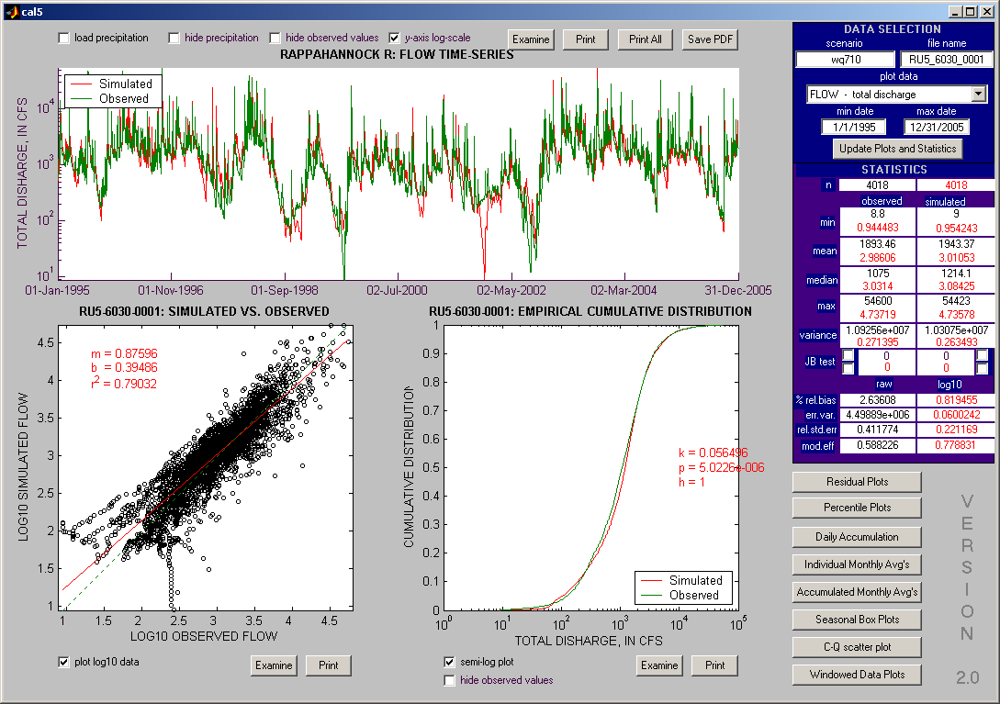

Slide 78
Virginia evaluated hydrology against their own set of criteria
Error in total volume >=20%
Error in low flow or base flow recession >=3.0%
Error in 50% lowest flow >=20%
Error in 10% highest flow >=25%
Error in storm volumes >=30%
Summer volume error >=40%
Winter volume error >=40%
Summer storm volume error >=75%
Storm peaks simulated verses observed for selected storms in inches >=30%

Slide 79
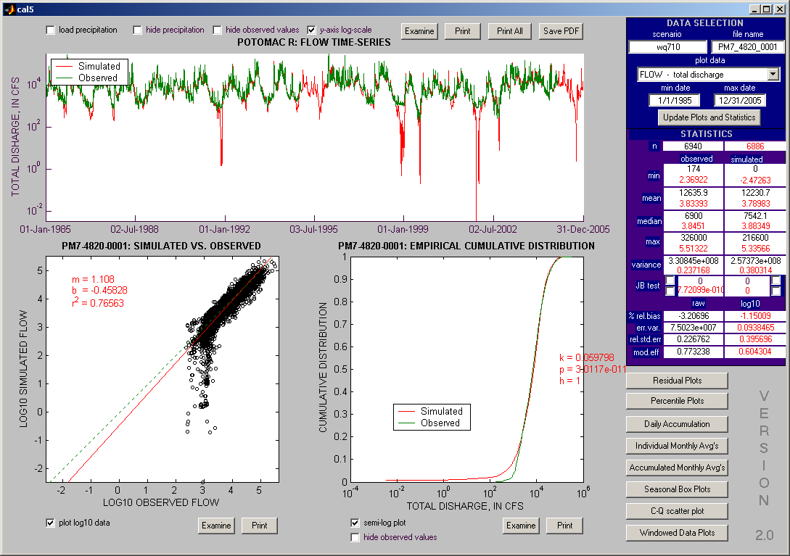

Slide 80
Problem diagnosis
Diagnosis focus on the following areas:
Point source
Diversion
Watershed characteristics
Calibration methodology
Scale

Slide 81
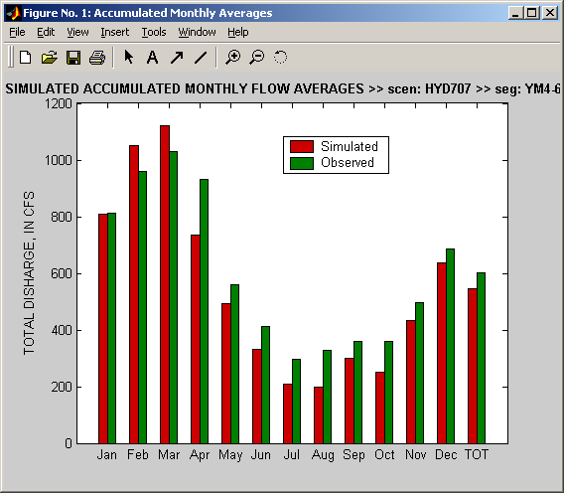
Potential problem with calibration methodology
LZSN is used to adjust winter/summer bias. For several stations, the chosen sensitivity was not adequate for the optimal LZSN to be reached.
Stations: YM4_6620_0003
YM2_6120_6430
JU3_6380_6900
The calibration for these
three stations can be
improved by increasing
the sensitivity of LZSN.

Slide 82
Basin characteristics outside of previous HSPF experience
The Chowan River Basin is a Dismal Swamp Basin. Since wetland is not simulated in the model, this may be the reason of over-simulated low flow problems in this basin.
Stations: MN0_8300_0001
MN2_8530_8510
MN4_8080_8110
MN5_8161_0003
The parameters controlling base flow - AGWR, AGWETP, already reached low limit. Unless we find a way to simulate wetland explicitly, the calibration in these stations will be difficult to improve.
Could Relax assumptions for these basins

Slide 83
13 segments with 3 or more characteristics significantly outside criteria during calibration
# of criteria violated Segment problem
8 PS0_6150_6160 Scale
7 OD2_8920_8830 Diversion
5 YM2_6620_0003 Method
5 JU3_6380_6900 Method
5 MN0_8300_0001 Wetland
4 YM2_6120_6430 Method
4 YP1_6570_6680 Scale and method
4 RL0_6540_0001 Different method
4 MN2_8530_8510 Wetland
4 OD2_8560_8630 Scale and method
3 PU2_6050_5190 Scale and method
3 MN4_8080_8110 Wetland
3 MN5_8161_0003 Wetland

Slide 84
TEMPERATURE Calibration

Slide 85
Land Processes - empirical
SURFACE
INTERFLOW
Groundwater

Slide 86
River Processes
Assume that heat exchange with the bed is proportional to longwave exchange with the atmosphere
Precip and Evaporation
Shortwave Radiation
OUTFLOW
Longwave Radiation
INFLOW
Sensible Heat Transmission

Slide 87
Strategy
Evaluate monthly Bias in Rivers and adjust upstream land parameters for baseflow and stormflow within reasonable limits
Run an optimization of the longwave parameter with respect to efficiency

Slide 88
Calibrate Temperature
1 iteration

Slide 89
Max efficiency with KATRAD
Process
Parameter
Files
Model Structure
Files
Optimization
Routine

Slide 91
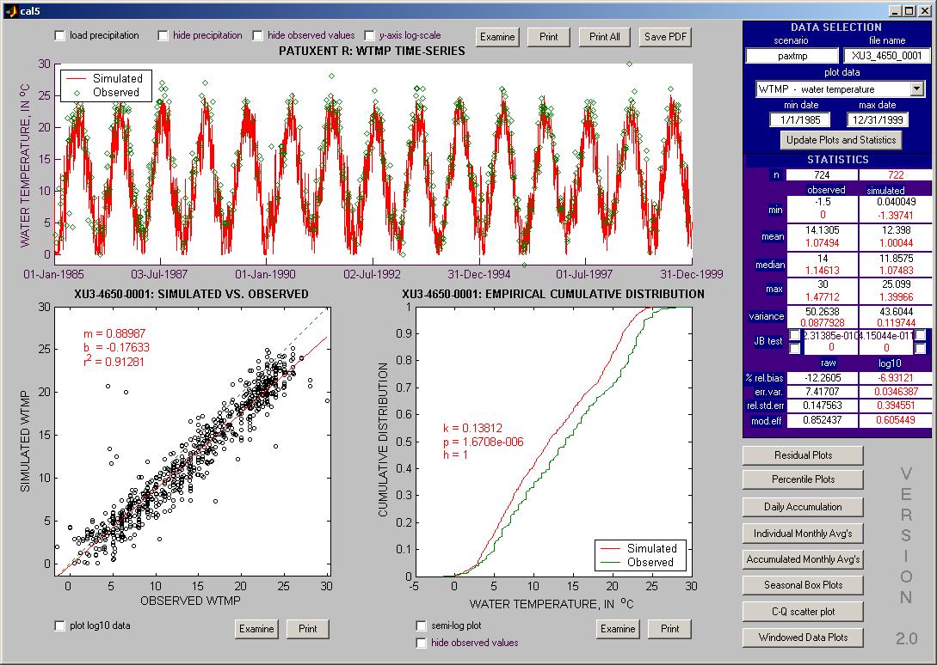
Land calibration only

Slide 92
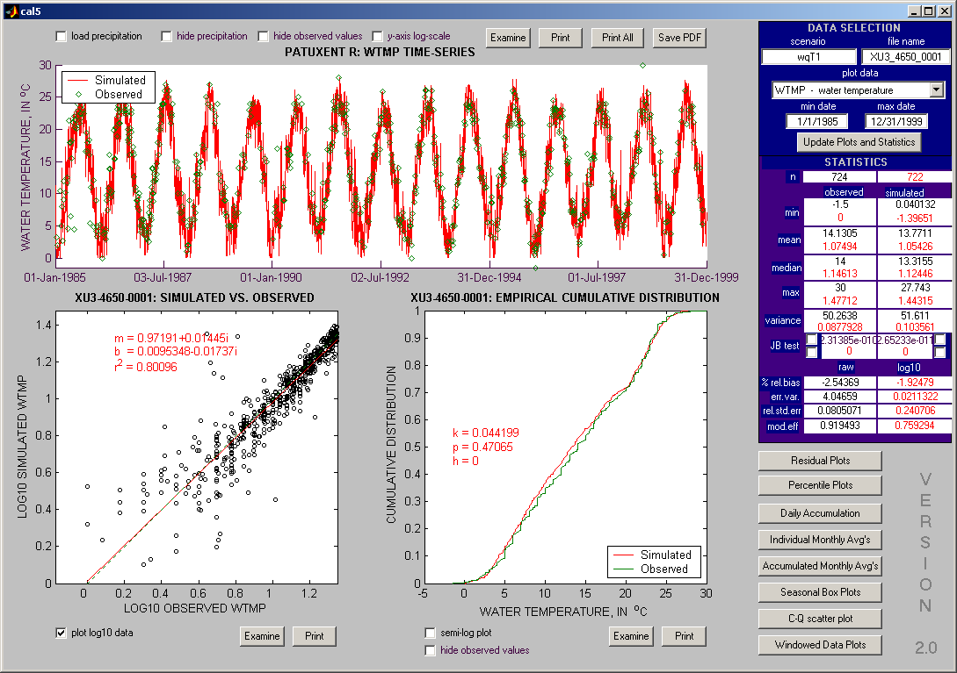
River and land calibration

Slide 94
LAND SEDIMENT Calibration

Slide 95
Sediment Pathway in Phase 5
Edge of Field
BMP Factor
1. Sediment processes are simulated on the land surface resulting in an Edge-Of-Field sediment load.
2. A time series of Best Management Practice (BMP) factors is applied based on available data.
4. A delivery factor based on local geometry is applied (see below), resulting in the Edge-Of-Stream load.
Land Acre Factor
Edge of Stream
Delivery Factor
3. A time series of land use acreage factors is applied.
5. Processes of deposition and scour are simulated in the stream, resulting in concentrations that can be compared to observations.
In Stream Concentrations
Notes:
For any particular watershed, the single simulated acre is multiplied by the number of acres of that land use in the watershed.
The different types of land uses are added together to get the total load to the stream.
The stream then has some scour and deposition depending on the velocity of the water

Slide 96
Sediment Pathway in Phase 5
Edge of Field
BMP Factor
There are two calibration points in this simulation.
1. Edge-of-Field loads are calibrated to expected values according to land use type or other data.
2. In-stream concentrations are calibrated where data are available (approximately 150 stations)
Land Acre Factor
Edge of Stream
Delivery Factor
In Stream Concentrations
Notes:
For any particular watershed, the single simulated acre is multiplied by the number of acres of that land use in the watershed.
The different types of land uses are added together to get the total load to the stream.
The stream then has some scour and deposition depending on the velocity of the water

Slide 97
Needed EOF targets for 13 land uses
Agriculture
Other
Forest
Harvested Forest
Extractive
Barren
Pervious Urban
Impervious Urban
Pasture
Degraded Riparian Pasture
Hay
High till with manure
High till no manure
Low till with manure
The National Resources Inventory program of the NRCS provided the CBP with estimates of Pasture and Crop by county, based on an aggregation of point measurements applied to RUSLE.
No such data available. Other data sources or analyses necessary.
13 land uses are being used for the sediment calibration. The other land uses are identical to one of the 13 for sediment purposes.

Slide 98
Needed EOF targets for 13 land uses
Agriculture
Land use % of model Target relative to NRI estimate
Pasture => Pasture
Poor Pasture => 9.5 * Pasture
Hay => 1/3 Crop (P4 NRI)
High till with manure => 1.25 * Crop
High till no manure => 1.25 * Crop
Low till with manure => 0.75 * Crop
9%
0.05%
7%
4%
1%
4%
NRI provided direct estimates for Pasture. Poor Pasture is pasture that is heavily trampled near streams. It is a small land use that exports at a high rate. NRI provided estimates for Hay for the phase 2 model. The estimates were generally 1/3 of crop for that data set, so the proportion was kept. Low till is generally 40% lower than High Till, so that ratio was applied with an average value of the NRI estimate.

Slide 99
Needed EOF targets for land uses not included in the NRI estimates
Other
Forest:
NRI estimates exist for phase 4 for the Chesapeake Bay watershed. Use these where available.
For simulated areas outside of the Chesapeake Bay watershed, use USLE populated by GIS estimates of factors. Ratio the results to that the range is equal to the range for the Chesapeake Bay Watershed
Harvested Forest:
Bare ground erosion rates of forest soils are three to four orders of magnitude greater than base forest erosion rates, but current practice in Mid-Atlantic Region does not reduce forests to bare ground generally.
Use 3.4 t/ac/yr as target rate, which is one order of magnitude greater than the average base forest rate.
Forest
Harvested Forest
Natural grass
Bare
Extractive
Pervious Urban
Impervious Urban
65%
0.65%
0.65%
0.52%
0.11%
7.1%
1.2%
The above land uses are discussed on the following pages

Slide 100
Needed EOF targets for land uses not included in the NRI estimates
Other
Natural Grass:
Similar to Pasture and probably confused with it in a GIS analysis. Use the NRI pasture numbers by county
Bare:
This is simulated as a construction land use with acreage based on the local annual change in urban land. Estimates of sediment export from construction sites in the literature range from 7-500 tons/ac/year. An ‘average’ value of 40 tons/ac/year is assumed.
Extractive:
Active mining operations are permitted at low rates of sediment export ≈ 0.16 tons/ac/year. Abandoned mines have waste piles and non-vegetated area that act more like construction sites. With high uncertainty and but low overall load assume that extractive areas have the relatively high load of 10 tons/ac/year
Forest
Harvested Forest
Natural grass
Bare
Extractive
Pervious Urban
Impervious Urban
65%
0.65%
0.65%
0.52%
0.11%
7.1%
1.2%

Slide 101
Needed EOF targets for land uses not included in the NRI estimates
Other
Urban:
Post-construction urban sediment loads is primary due to channel erosion from increased concentrated flow from impervious surfaces.
National Urban Runoff Program data are several decades old limited in applicability.
Large amounts of data were collected under the phase I stormwater regulations, but studies by Penn State and University of Alabama have not been able to make predictive models from the collected data.
Use Langland and Cronin (2003) estimates of urban EOS erosion rates by land use category.
(following page)
Forest
Harvested Forest
Natural grass
Bare
Extractive
Pervious Urban
Impervious Urban
65%
0.65%
0.65%
0.52%
0.11%
7.1%
1.2%

Slide 102
Urban Sediment Targets
Sediment load for several urban land use types were compiled for sites in the mid-Atlantic and Illinois. Langland and Cronin (2003)
When plotted against ‘typical’ impervious percents for those urban land use types, the relationship is striking.
By setting pervious urban at the intercept and impervious urban at the maximum, the land use division within each particular segment determines the overall load according to the above relationship.

Slide 103
Calibration of the Land Sediment Simulation to the Targets
Detached Sediment is generated through two separate processes:
Generation, which is a set daily addition to detached sediment is often conceptualized input from the atmosphere, but in the case of phase 5, it is conceptualized as sediment becoming detached through the drying process. The parameter NVSI is the daily input
Rainfall Detachment, which is governed by the percentage of the ground that has vegetative cover, the rainfall intensity, and the parameter KRER.
Detached Sediment
(reservoir available for washoff)
Washoff is related to antecedent moisture storage in the surface layer, surface runoff, and the parameter KSER, and is limited by the storage of detached sediment.
Wash off
KSER
Rainfall
Detachment
KRER
Attachment
Generation
AFFIX
NVSI
Re-attachment is modeled as a daily percent of the detached sediment and tends to make the storage asymptotic. The parameter AFFIX is the daily percentage.
Soil Matrix
(unlimited)
4 parameters, 1 target

Slide 104
Calibration Goal - Zero Detached Sed after Large Storms
Reduce the parameter set by enforcing calibration rules
Sediment transport has a natural hysteresis whereby storms that happen soon after other storms tend to have lower in-stream concentrations than the antecedent storms. This effect is negligible after 30 days. It is unclear if this is a river or land surface process, but there is no mechanism in the river simulation in HSPF to enforce this.
vanSickle and Beschta (1983)
Allen Gellis (personal communication)
Surface Runoff
Detached Sediment Storage
Washoff
To make this happen, AFFIX must be appropriately set, NVSI must be significant, and KRER must be small enough relative to KSER to avoid detached sediment buildup

Slide 105
Rule 1: Set AFFIX so that Detached Sediment storage reaches 90% of its max in 30 days
⬅ Basic HSPF equation where S = storage
⬅ At dS/dt = 0
⬅ For storage = 0 at t = 0
Solve equations so that detached storage versus time has the desired properties of reaching 90% of asymptote in 30 days.
AFFIX = 0.07673

Slide 106
Rule 2 – Generation makes up significant
portion of Detached Sediment
Detached Sediment
Generation and Rainfall Detachment can both generate detached sediment.
The proportion of the detached sediment made up of generation is positively related to the amount of hysteresis in the simulation.
Generation
Rainfall
Detachment
KRER
NVSI
Soil Matrix
(unlimited)
NVSI = [significant fraction] * target load

Slide 107
Rule 3 – KRER is a percentage of KSER
Detached Sediment
(reservoir available for washoff)
Wash off
KSER
Rainfall
Detachment
KRER
Attachment
Generation
AFFIX
NVSI
Soil Matrix
(unlimited)
Excessive KRER relative to KSER will lead to a buildup of detached sediment, so that KRER is a percentage of KSER

Slide 108
Strategy: Reduce the Parameter Set
1. Fix AFFIX
2. Assume ratio of NVSI : EOF target
3. Assume ratio of KSER : KRER
4. Adjust KSER to meet target
1 parameter, 1 target
Make several runs with different ratios (#2, 3)
Detached Sediment
Wash off
KSER
Rainfall
Detachment
Attachment
Generation
KRER
AFFIX
NVSI
Soil Matrix
(unlimited)

Slide 109
Land Calibration Strategy:
Run several scenarios with varying ratios of NVSI:Target load and KSER:KRER
Disallow scenarios that exhibit excessive buildup of detached sediment or unreasonable parameter values
Choose the scenario that best fits observed in-stream data

Slide 110
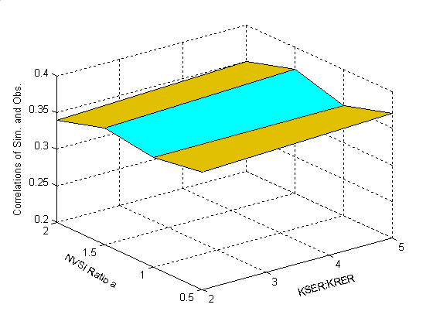
Different scenarios make little difference on the correlation of simulated and observed concentrations
Correlation of sediment concentrations for each of 8 scenarios

Slide 111
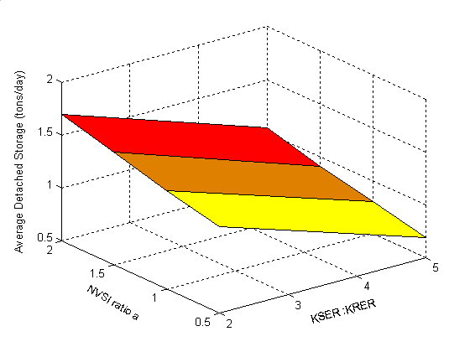
Average detached storage decrease with Decrease of NVSI ratio and Increase of KSER/KRER ratio
More hysteresis
Greater effect of plowing
Average detached storage for each of 8 scenarios

Slide 112
Land-to-Water Delivery Factors
Edge of Field
BMP Factor
Edge of Stream
Land Acre Factor
Delivery Factor
Land uses are not evenly distributed around a segment and some segments are larger than others.
A method to assign a differential delivery factor for each land cover class and segment is shown on the following slide.
In Stream Concentrations
Notes:
For any particular watershed, the single simulated acre is multiplied by the number of acres of that land use in the watershed.
The different types of land uses are added together to get the total load to the stream.
The stream then has some scour and deposition depending on the velocity of the water

Slide 113
Sediment delivery factors by land use and segment
Several publications were found that relate sediment delivery to watershed size. The most appropriate one was judged to be the SCS method:
DF = 0.417762 * Area ^{-0.134958} - 0.127097
The delivery factor needed for the phase 5 model is from land cover pixels to the stream, not to the watershed outlet, so it is not appropriate to use the size of the watershed.
To generate a deliver factor for each land use, the average distance of that land use to the stream was used as radius of a circle. The area of that circle was used to calculate the delivery factor.
To illustrate this approach, suppose a land use type that is scattered throughout a segment were gathered into a single area, but the distances to the stream were preserved. The average delivery of that cluster would be roughly equal to the average delivery from a circle with a center that was co-located with the center of mass of the land use.

Slide 114
LAND NUTRIENT Calibration

Slide 115
Nutrient Calibration Multiple Plans
Land nutrients – 2 simulation approaches
Full physically-based simulation - AGCHEM
Empirical approach – PQUAL
River nutrients and sediment – 2 calibration approaches
PEST – USGS
Rule-based – CBP

Slide 116
Nutrient EOF Targets
Purpose: Develop targets that:
Appropriately order the influence of different land uses in the same area
Appropriately account for differences in loading between the same land uses in different areas.
Regional differences due to physiographic effects will be resolved through load balancing in the river calibration.

Slide 117
Sources of Data
Literature Reviews
Beaulac & Reckhow (1982)
Sweeney (2001)
Lin (2004)
Primary Sources (about 30)
Previous Modeling Studies
Phase 4.3
Sparrow

Slide 118
Targets
Chose average export load based on literature
Created method of differentiating between the same land use in different segments based on the balance of inputs and uptake

Slide 119
Average Targets
Land Use TN TP
Forest 2.0 0.15
Harvested Forest 20.0 0.80
Crop 23.0 2-2.5
Hay 6.0 0.4-0.8
Pasture 4.5 0.7
Urban 9.3 1.5
Extractive 12.5 3.5
Nursery 240 85

Slide 120
Differentiating between regions
Forest – Assume constant loss efficiency
Crop –
median balance = median export
Zero balance = ½ median export
Urban – Assume constant concentration
No method of differentiation for
Alfalfa, construction, extractive, harvested forest, hay without nutrients, nurseries

Slide 123
Calibration Targets – 8 for each land use
}
NH₃
NO₃
Labile ORGN
Refractory ORGN
SURFACE
INTERFLOW
(“slow” surface flow)
lower soil layer
NH₃
NO₃
Labile ORGN
Refractory ORGN
Groundwater

Slide 124
P and N simulation in AGCHEM
TN
TP
DIN
OrgN
Labile OrgN
Labile OrgP
OrgP
DIP
Refractory OrgN
Refractory OrgP

Slide 125
AGCHEM and PQUAL
AGCHEM –
Mass Balance / Reaction Rate Based Mechanistic Simulation
Responsive to inputs and uptake
PQUAL
Empirical, coefficient-based simulation
Sensitive to hydrology and sediment only

Slide 126
AGCHEM simulation
After HSPF documentation
Trees
Denitrification
Roots
Leaves
Nitrate
Atmospheric Deposition
Export
Solution
Particulate
Particulate
Ammonia
Labile
Refractory
Organic N
Organic N
Export
Export
Export
Export
Export
Export
Adsorbed
Solution
Solution
Ammonia
Labile
Refractory
Organic N
Organic N

Slide 127
PQUAL / IQUAL Simulation
NH3 = flow * conc +
sed * factor
SURFACE
INTERFLOW
NH3 = flow * conc
Groundwater
NH3 = flow * conc

Slide 129
PQUAL simulation for PO4 in forest and urban
P simulation in forest and urban unable to calibrate effectively in AGCHEM mass-balance routine
P in forests comes from change in storage or natural weathering, If we are trying to create a dynamic mass balance we will always run out of P.
P in urban comes from river channels downstream of the land use. Again a violation of mass balance on the land.
Both land uses are not sensitive to inputs on the P side. They are sensitive primarily to hydrology.
PQUAL has sensitivity to hydrology and is easier to calibrate than AGCHEM
Note: typically storages are reset each Jan 1 in HSPF applications. In phase 5, they are not reset so that the effect of dry/wet years can be modeled

Slide 130
Calibration of land nutrients
System of Rules that balances
Export Targets
Uptake Targets
Stable Storages
Parameter limits
Optimization
Routine

Slide 131
Goals of the Land Calibration
Nitrogen and phosphorus loads match targets reasonably well
Plant uptake matches field data reasonably well
Calibrated model parameters within a fairly constrained range
Model sensitive to management actions

Slide 132
Percent of total acreage
64.3%
7.8%
Percent of total TN loads
28.3%
38.8%

Slide 133
Crops with uptake targets
Land use in this category:
High till corn/soy/grain
High till without manure
Low till corn/soy/grain Yield-based uptake method
Hay with manure
Alfalfa
Pasture First-order uptake method
Both EoF targets and crop uptake need to be reached

Slide 134
Nitrogen Cycle in Watershed Model
(After HSPF documentation)
Trees
Denitrification
denitrification
Roots
Leaves
Nitrate
Atmospheric Deposition
Export
nitrification
Nitrate/ammonium
immobilization rate
Solution
Particulate
Particulate
Ammonia
Labile
Refractory
Volatilization
organic N mineralization
Organic N
Organic N
partitioning coefficient
for labile organic N
partitioning coefficient
for refractory organic N
Export
Export
Export
Export
Solution
Export
Solution
Export
Adsorbed
Refractory
Labile
Ammonia
Organic N
Organic N

Slide 135
Decision Rules - Nitrogen
Optimize parameters to reach EoF targets and crop uptake
- Adjust organic N mineralization rate to reach balance between Organic
N and Inorganic N
- Adjust nitrification rate and denitrification rate to reach NH4 and NO3 targets
- Adjust particulate/soluble partitioning coefficient to reach Organic N
targets
- Adjust NH4/NO3 immobilization rate and Wilting Points to reach
uptake targets
Optimize initial storages of organic N to stabilize storage over time

Slide 136
Pasture is handled differently in two aspects:
1 . Wilting points not applicable, adjust NH4/NO3
immobilization rate only to reach uptake
2 . Optimize ammonia volatilization rate to get rid of
NH4, when surface DIN 20% higher than targets

Slide 137
Decision Rules - Phosphorus
Parameters subject to calibration
Decision rules
- Adjust phosphate immobilization rate to control transformation inorganic P
- Adjust Organic P mineralization rate to reach uptake targets
- Adjust coefficient in the single-value Freundlich isotherm to reach PO4
targets
Plant
-
P
P
lant
Uptake
Adsorption
Mineralization
Adsorbed Phosphate
(PO4-A)
Phosphate in Solution
(PO4-S)
Organic Phosphorus
(ORG-P)
Desorption
Immobilization

Slide 138
AGCHEM land uses without Uptake Targets
Land use in this category:
Forest
Hay without manure
High intensity pervious urban
Low intensity pervious urban
Uptake data not available, only to reach EoS targets

Slide 139
Decision Rules - Nitrogen
Parameters subject to calibration
Same as crop land, except NO3 immobilization rate and wilting point
Decision rules
1. Optimize parameters to reach EoS targets
- Adjust organic N mineralization rate and NH4 immobilization rate to
reach balance between Organic N and Inorganic N
- Adjust nitrification rate and denitrification rate (below surface ONLY)
to reach NH4 and NO3 targets
- Adjust particulate/soluble partitioning coefficient to reach Organic N
targets
2. Optimize initial storages of organic N to stabilize storage
over time

Slide 140
Decision Rules - Phosphorus
Parameters subject to calibration
same as crop land uses
Decision rules
- Adjust immobilization rate/mineralization rate
to reach balance between Org P and inorganic P
- Adjust Coefficient in the single-value Freundlich
method to reach PO4 targets

Slide 141
High tillage Corn/soy/grain

Slide 142
Low tillage Corn/Soy/Grain

Slide 143
High tillage Other

Slide 144
Pasture

Slide 145
Alfalfa

Slide 146
Hay with manure

Slide 147
Hay with/o manure
Forest

Slide 148
High density pervious urban
Low density pervious urban

Slide 149
Comparison of regular crop and nutrient management crop
Use the calibrated land parameters to run nutrient management (NM) land
Test model’s capacity of simulating management actions
TN, total PO4, and plant uptake compared
**** not fully confident in input data

Slide 150
High till CSG ~ NM high till
Total Nitrogen export
On average,
39% lower from NM
Total Phosphate export
On average,
49% lower from NM

Slide 151
High till CSG ~ NM high till
Total Nitrogen uptake
Total Phosphorus uptake

Slide 152
High without manure ~ NM high till
Total Nitrogen export, 44% lower from NM
Total PO4 export, 76% lower from NM
Total Nitrogen uptake
Total Phosphorus uptake

Slide 153
Low till CSG ~ NM low till
Total Nitrogen export, 44% lower from NM
Total PO4 export, 47% lower from NM
Total Nitrogen uptake
Total Phosphorus uptake

Slide 154
Hay with manure ~ NM hay
Total Nitrogen export, 45% lower from NM
Total PO4 export, 13% lower from NM
Total Nitrogen uptake
Total Phosphorus uptake

Slide 155
Pasture ~ NM pasture
Total Nitrogen export
Total PO4 export
Total Nitrogen uptake
Total Phosphorus uptake

Slide 156
Percentile of calibrated parameters (log scale)
NO3 immobilization rate
NH4 immobilization rate

Slide 157
Organic N mineralization rate
Nitrification rate
Denitrification rate

Slide 158
Partitioning coefficient for labile org N
Partitioning coefficient for refractory org N

Slide 159
PO4 immobilization rate
Organic P mineralization rate
Adsorption/desorption coefficient

Slide 160
Summary
Simulated N and P targets largely matched
Plant uptake matches field data reasonably well
Calibrated model parameters within a fairly constrained range
Model sensitive to management actions

Slide 161
RIVER Calibration

Slide 162
Sediment Calibration Stations

Slide 163
Calibration Information
Observed and simulated CFDs for paired data
Consistent with recommendations of STAC review team

Slide 164
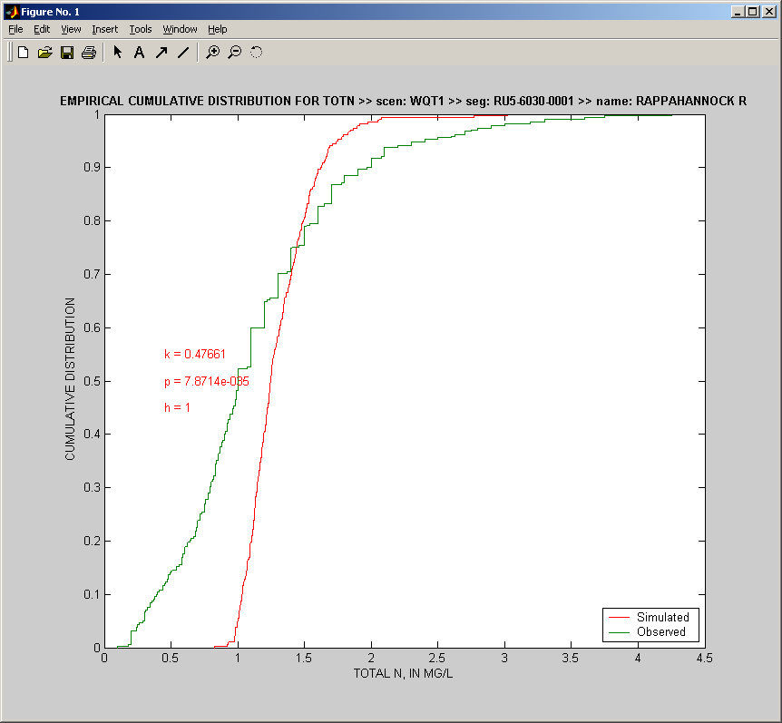
Bin 5
Bin 4
Bin 3
Bin 2
Bin 1

Slide 165
Sediment Calibration
Silt Erodibility related to upper quintile
Clay Erodibility related to upper 2 quintiles
Critical Shear Stress for scour is based on the relationship between Median and upper quintile
if upper quintile is more biased than the median, lower critical shear stress to even out
Clay settling related to lower 2 quintiles
Silt settling related to 2nd and 3rd quintiles
. . .

Slide 166
Rule-Based Optimization
River Calibration
Process
Parameter
Files
Assume the sensitivity of the simulation to each parameter
Determine an appropriate adjustment direction for each parameter
Take a small step in that direction

Slide 167
Potomac Calibration
Change in transformation vs iteration

Slide 168
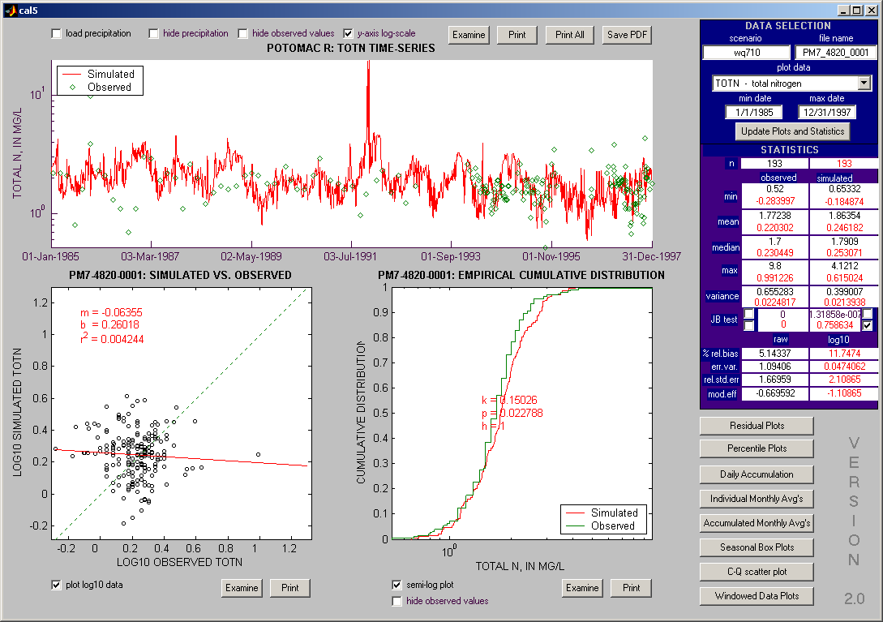

Slide 172
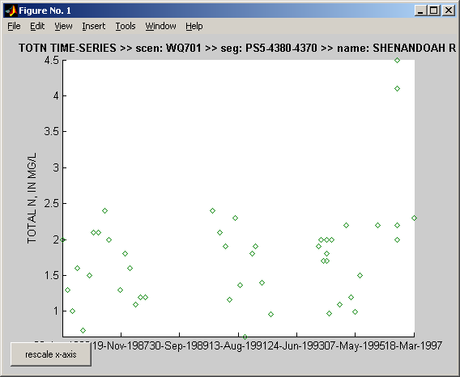
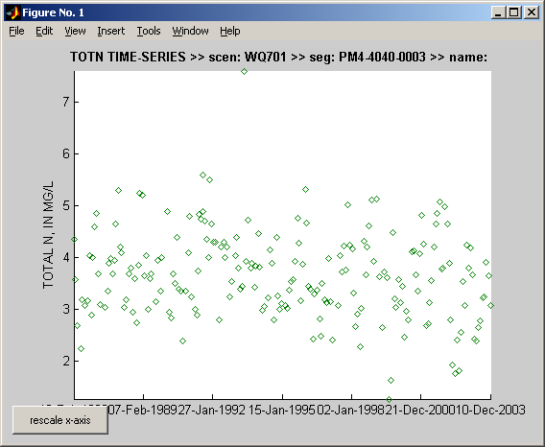
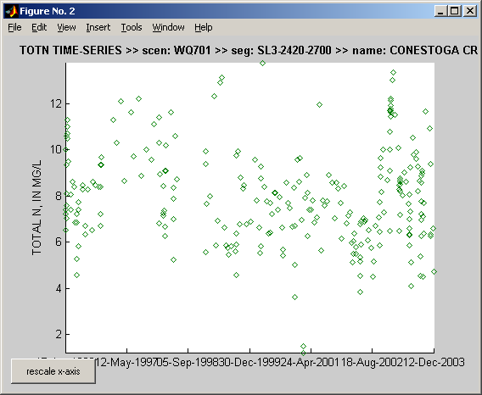
Similar watersheds Different Concentrations
Shenandoah
Monocacy
3.5
1.5
8 !!
Conestoga

Slide 175
Sediment & Nutrients in Phase 5
Edge of Field
BMP Factor
Regional Factor
Land Acre Factor
Edge of Stream
Delivery Factor
In Stream Concentrations
Notes:
For any particular watershed, the single simulated acre is multiplied by the number of acres of that land use in the watershed.
The different types of land uses are added together to get the total load to the stream.
The stream then has some scour and deposition depending on the velocity of the water

Slide 176
How to arrive at appropriate Edge of Stream loads?
Assume watershed with one river and a gauge
Start from the outlet
Add stream attenuation
Leaves necessary EOS

Slide 177
In Theory . . .
2
Using ESTIMATOR and Sparrow estimates of river flux and attenuation, we can empirically calculate overall necessary EOS loads.
1
3

Slide 178
Mass-Balance,
Literature, &
Previous Analyses
Edge of Field Export Targets
Sub-basin transport factor specific
to each estimator location
Edge of Stream
From Land
Other EOS Loads
Point, Atdep, Septic
Phase 5
Input Data
Phase 5
Input Data
+
National
Sparrow Model
Transport factors from Sparrow + Diversion Losses
USGS and
Ping Wang
Data Analysis
Estimator
Load

Slide 179
Mass Balance
Current Inputs:
Si + P + A + S + E
Needed inputs
(Si + P + A + S + E) / Bso
Inputs after factor application
Si/Bsi + P + A + S + E*T
Si = upstream load
Bsi = upstream load bias
Bso = outlet load bias
P = point source
A = Atmospheric Deposition
S = Septic
E = Edge-of-stream load
T = Transport factor
T = (Si*(1-Bso/Bsi) + (P+A+S)(1-Bso) + E)
/ (E * Bso)

Slide 180
Nested
Optimization
River Calibration
Calculate necessary EOS to unbias the calibration
Adjust EOS by that amount
Assume the sensitivity of the simulation to each parameter
Determine an appropriate adjustment direction for each parameter
Take a small step in that direction

Slide 181
TN Station Influence

Slide 182
TP Station Influence

Slide 183
TN Calibrated factors

Slide 184
TP Calibrated factors
MUST UPDATE THESE

Slide 185
TN Coastal Plain

Slide 186
TP Coastal Plain

Slide 188
Uncertainty Analysis

Slide 189
Calibration Process
RUN TIME
Hydrology
Land parameters
River data
1 week
Temperature
Land parameters
River parameters
River data
Land Sediment
Land parameters
Land targets
1 week
Land Nutrients
Land parameters
Land targets
1 week
River Water Quality
River parameters
River targets
1 week

Slide 190
Uncertainty Analysis - Hydrology
Calibrated Parameters
7 * 308 = 2156
All land uses independent
24 * 7 * 308 = 51744
Meta
7 * 23 (parameter relations)
9 * 2 (limits)
7 sensitivities
= 186 specifications for hydrology

Slide 191
Uncertainty Analysis – land sediment
Calibrated Parameters
1 * 308 * 24 = 7392
Targets
308 * 24 = 7392
Meta
2 (parameter relations) – this sensitivity was performed

Slide 192
Uncertainty Analysis – land nutrients
Calibrated Parameters
10 * 308 * 24 = 73920
Targets
308 * 24 * 8 = 59136
Meta
20 rules to govern parameter modification

Slide 193
River water quality
Calibrated Parameters
41 * 739 = 30299
Meta
41 parameter adjustment rules

Slide 194
Chesapeake Bay Program Decision Support System
Land Use
Change Model
Bay
Model
Criteria
Assessment
Procedures
Watershed
Model
COAST
Data
Airshed
Model
Effects
Allocations

Slide 195
Uncertainty of Decision
Decision is made by calculating load necessary for Water quality standards
Divide the load into regions by
(2010 no BMPs – 2010 all forest) * factor – 2010 all forest

Slide 196
Decision Algorithm
Desired State of Real Data
(ag census)
(BMP implemtation #s)
Real Data (ag census)
(BMP implemtation #s)
Allocation
Method
Assumptions or model
Model Inputs
HSPF
WQ
Standards
Method
Parameters
WSM
Bay Model
Calibration
skill
Calibration Theory

Slide 197
Uncertainty Analysis
Desired State of Real Data
(ag census)
(BMP implemtation #s)
Real Data (ag census)
(BMP implemtation #s)
Allocation
Method
Assumptions or model
Model Inputs
HSPF
WQ
Standards
Method
Parameters
WSM
Bay Model
Calibration
skill
Calibration Theory

Slide 198
Uncertainty Analysis
Desired State of Real Data
(ag census)
(BMP implemtation #s)
Real Data (ag census)
(BMP implemtation #s)
Allocation
Method
Assumptions or model
Model Inputs
HSPF
WQ
Standards
Method
Parameters
WSM
Bay Model
Calibration
skill
Calibration Theory

Slide 199
Uncertainty Analysis
Desired State of Real Data
(ag census)
(BMP implemtation #s)
Real Data (ag census)
(BMP implemtation #s)
Allocation
Method
Assumptions or model
Model Inputs
HSPF
WQ
Standards
Method
Parameters
WSM
Bay Model
Calibration
skill
Calibration Theory

Slide 200
Uncertainty Analysis
Desired State of Real Data
(ag census)
(BMP implemtation #s)
Real Data (ag census)
(BMP implemtation #s)
Allocation
Method
Assumptions or model
Model Inputs
HSPF
WQ
Standards
Method
Parameters
WSM
Bay Model
Calibration
skill
Calibration Theory

Slide 202
Modeling and Monitoring

Slide 203
Interactions between monitoring data and models
Model Calibration
100 to 200 river reaches in the Chesapeake watershed
Small-scale land-use specific loads
Predictions of management effectiveness

Slide 204
Area monitored by RIM
Stations

Slide 205
These charts based on CBP watershed model phase 4.3

Slide 206
A good example of a ‘banana plot’ that is showing an upward tail when the trend is actually flat

Slide 207
Three methods of ‘Flow-adjusting’ the Potomac Phosphorus
Most USGS ‘banana plots’ are reasonable, but there are specific problems with the Potomac Phosphorus.
These three plots of long term trend are all based on the same data but have drastically different short-term implications.
Yellow – approximation of USGS ‘banana plot’ from last year using quadratic trend
Blue – discrete form of flow-adjustment
Green – step trend term rather than quadratic
*** provisional analysis ***
** do not distribute **

Slide 208
*** provisional analysis ***
** do not distribute **
If the flow-adjusted trends are multiplied by the loads are the RIM sites, an overall flow-adjusted reduction percentage can be calculated.
This is comparable to the Watershed model phase 4.3 predictions of reductions based on implemented management practices.

Slide 209
Climate Change

Slide 210
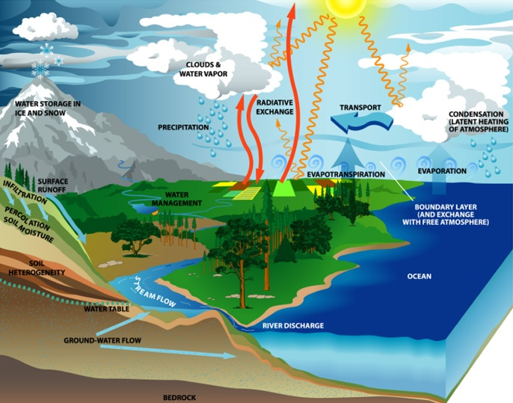
Estimated Climate Change Effects in the Chesapeake Region
In our region, temperatures are estimated to increase with a high degree of certainty, and precipitation to increase, especially at higher rainfall events, with a moderate degree of certainty.
How this effects flow in the watershed hangs in a hydrologic balance between precipitation and evapotranspiration.
About half the annual Chesapeake watershed precipitation inputs are lost by evapotranspiration.

Slide 211
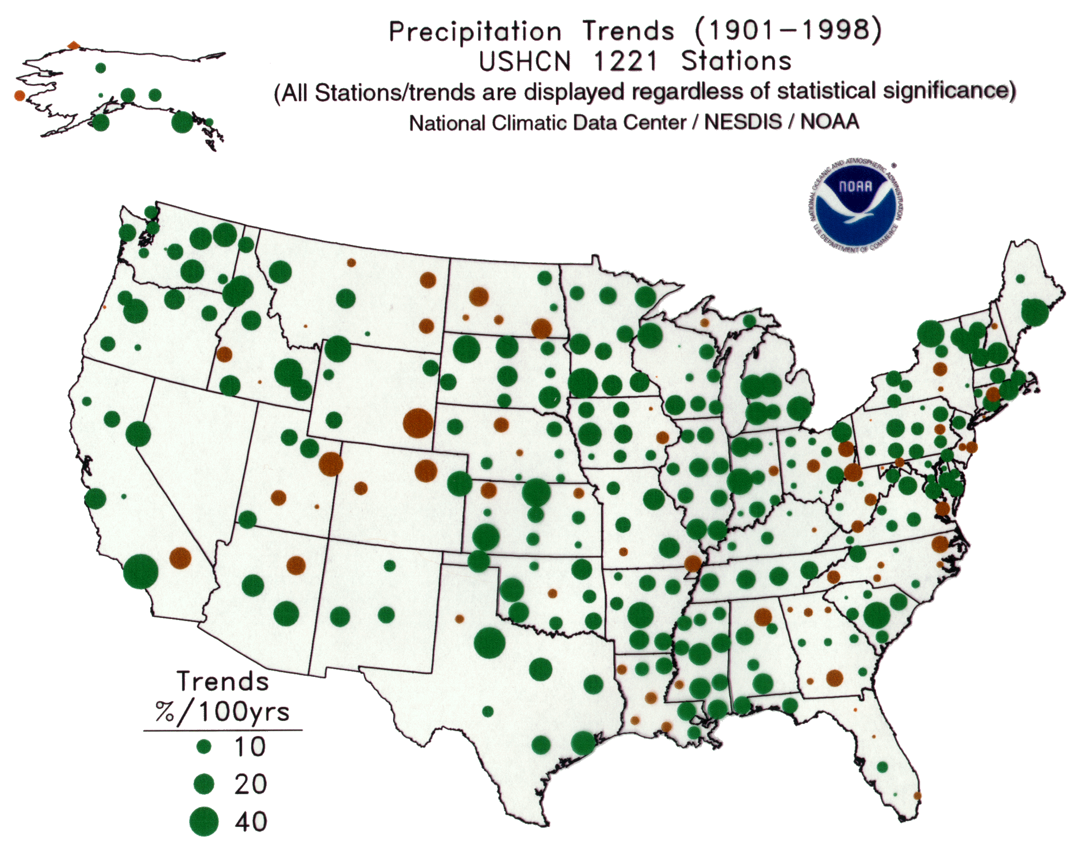
Observed Temperature and Precipitation Trends (1901-1998)
Looking back over the
observed record for
the last century.
Annual Precipitation Total
Green = increase
Brown = decrease

Slide 212
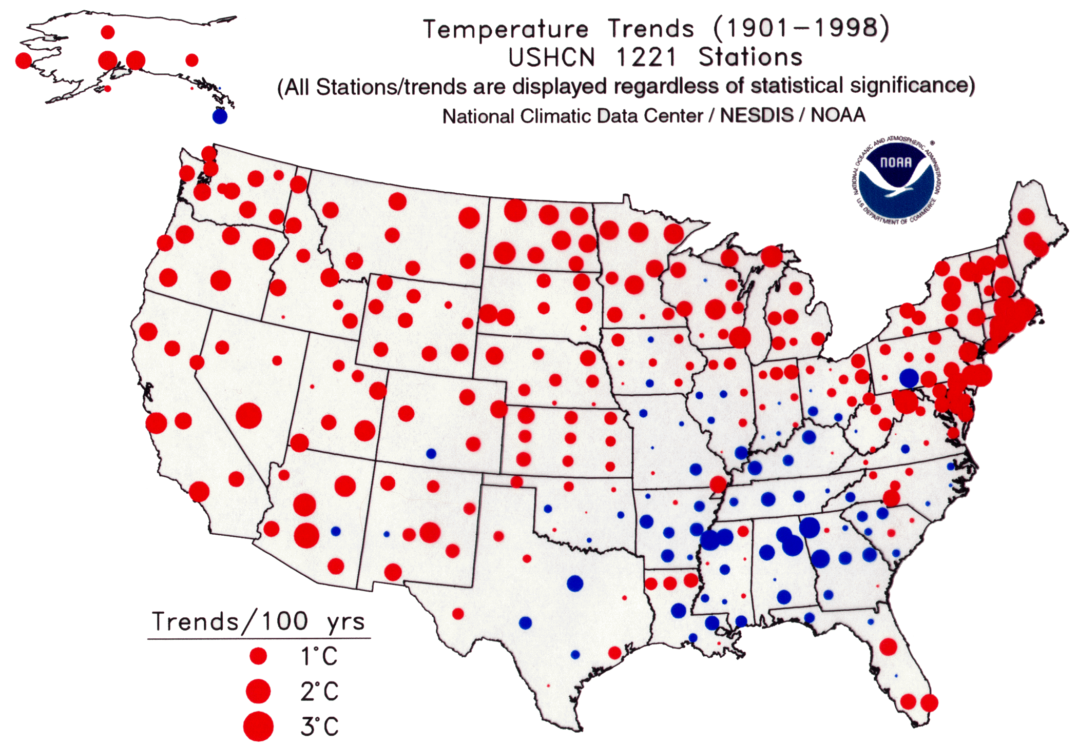
Observed Temperature and Precipitation Trends (1901-1998)
Mean Annual Temperature
Looking back over the
observed record for
the last century.
Red = increase
Blue = decrease

Slide 213
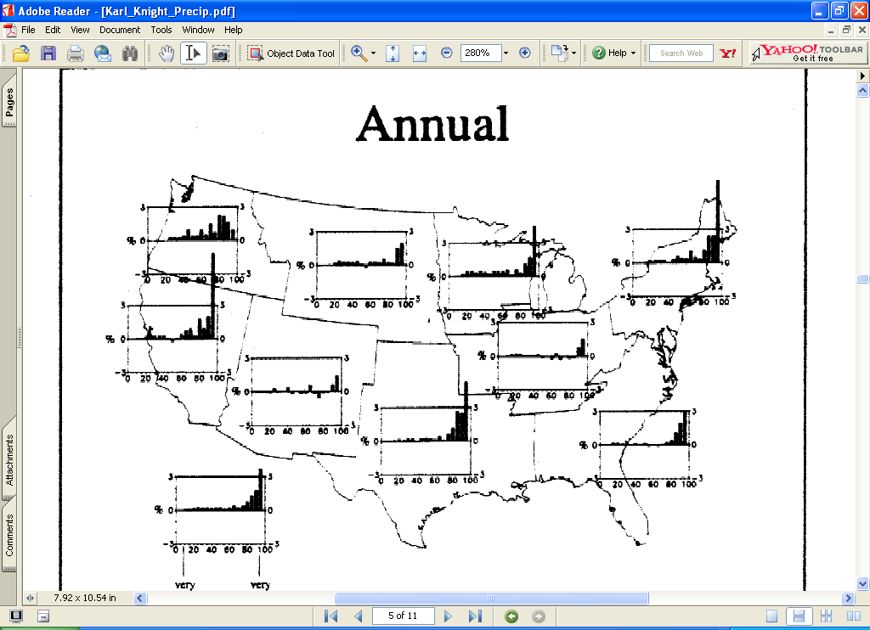
Observed trends in precipitation by size class (percent per century, 1910-1996)
70th percentile
National
Average
Source: Karl and Knight, 1998

Slide 214
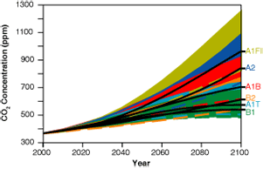
Two emission scenarios from the UN’s Intergovernmental Panel on Climate Change (IPCC) were used.
Projected CO₂ concentrations using IPCC “SRES” storylines
A2 emission scenario - A very heterogeneous world of economic growth where the underlying theme is self-reliance and preservation of local identities. Fertility patterns across regions converge slowly, which results in continuously increasing population. Economic development is primarily regionally oriented and per capita economic growth and technological change are more fragmented and slower than other storylines.
B2 emission scenario - A world in which the emphasis is on local solutions to economic, social, and environmental sustainability. It is a world with continuously increasing global population, but at a lower rate than A2, and with intermediate levels of economic development, and technological change. While the scenario is oriented toward environmental protection and social equality, it focuses on local and regional levels.

Slide 216
Nutrient Speciation

Slide 217
Organic Simulation
Labile ORGN
DIN
BOD
P:N =
0.1384
Algae
P:N =
0.1384
DIP
Labile ORGP
DIN
Benthic
Algae
P:N =
0.1384
0.1384
0.1384
Refract ORGN
DIP
Refractory
ORGN
0.1384
Refract ORGP
Refractory
ORGP
Median Observed ORGN:ORGP ratio is 0.056

Slide 218
TN
TP
TN*FDIN
TN*(1-FDIN)
TN*(1-FDIN)(1/11)
TN*(1-FDIN)(1/11)(0.1384)
DIN
OrgN
Labile OrgN
Labile OrgP
OrgP
DIP
Refractory OrgN
Refractory OrgP
TN*(1-FDIN)(2/11)(0.1384)
TN*(1-FDIN)(10/11)
TN*(1-FDIN)(10/11)(0.1384/10)
PO4 = TP - TN*(1-FDIN)(2/11)(0.1384)
Can plug in TP, TN, and DIP to find FDIP
But we have targets for all of these numbers
FDIP = (TP - TN*(1-FDIN)(2/11)(0.1384))/TP
Rearranging:
TP(1-FDIP) - TN*(1-FDIN)(2/11)(0.1384) = 0
Let x be the fraction deviation for each targeted value to achieve an equality
TP*x*(1-FDIP*(1/x)) – TN*(1/x)*(1-FDIN*x)(2/11)(0.1384) = 0
Quadratic equation
X2 * TP + x * (TN * FDIN * 2/11 * 0.1384 - TP * FDIP) – TN * 2/11 * 0.1384 = 0

